Slide 1
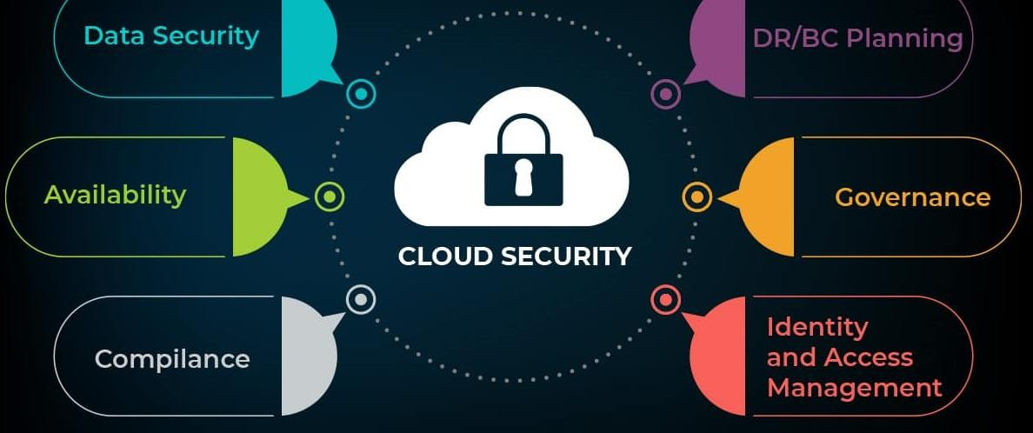
Auditing & Securing The Cloud.
1

Slide 2
Module 8 – Securing The Cloud.
Cloud has become the nest of all operation activity for daily ²
operations whence hackers see cloud as a fruit bearing jackpot.
The delivery of computing services—including servers, storage, databases, networking, software, analytics, and intelligence—over the Internet (“the cloud”) to offer faster innovation, flexible resources, and economies of scale.
Objectives:
▶ Understand Types of clouds & Services they offer.
▶ Cloud Advantages.
▶ Threats to clouds & countermeasures.
▶ Cloud Privacy Issues and how to address them.
▶ Choosing the cloud correctly

Slide 3
Securing The Cloud.
Types of Cloud Architecture.
3
Cloud has Four flavors catering to different needs of consumers
▶ Private Cloud – For Single Entity or Org- Orgs Private storage especially with sensitive data.
▶ Public Cloud – Owed by service provider and shared by several resource tenants.
▶ Community Cloud – Belongs to a group of organizations with similar interests.
▶ Hybrid Cloud – A mix of two or more different kinds of architectures. (like Amazon Web Services (AWS), Microsoft Azure, or Google Cloud)

Slide 4
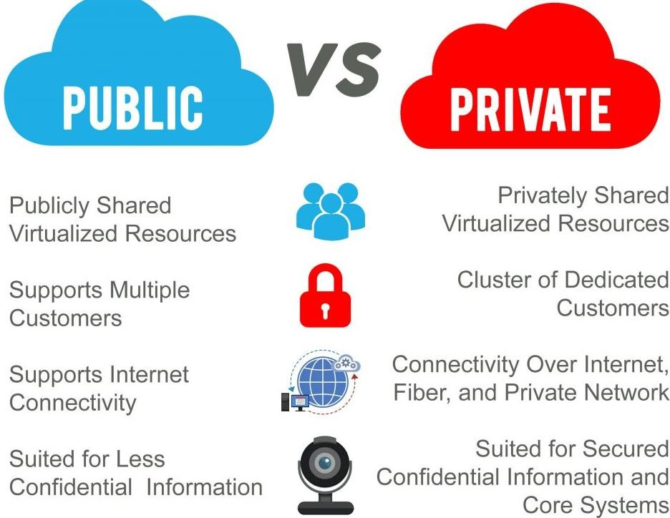
Securing The Cloud.
Types of Cloud Architecture Comparison.
4

Slide 5
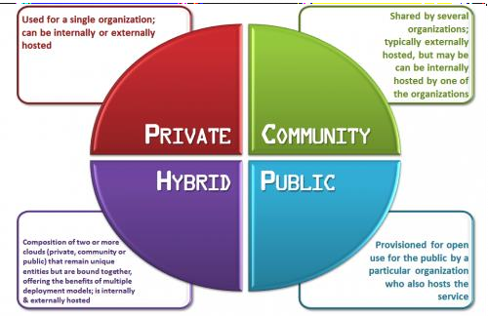
Securing The Cloud.
Types of Cloud Architecture Comparison.
5

Slide 6
Securing The Cloud.
Types of Cloud Computing
6
▶ IaaS– (Infrastructure as a Service) ITs Infrastructure is provided to clients in form of either N/W,Virtual PCs & storage space.
▶ PaaS–(Platform as a Service) Consumers are given the chance to only focus on the applications that they run on cloud, other complexities of building& maintaining the infrastructure is done by the cloud service provider.
▶ SaaS– (Software as a Service)-Belongs to a group of organizations with similar interests.

Slide 7

Securing The Cloud.
Cloud Threats
7
▶ Data Breach – More devastating as it targets multiple users
▶ Data Loss.
▶ Account Hacking.
▶ Disgruntled Insider.
▶ Technology Loop Holes.
▶ Shared Space – One user peeping into other user’s data is ennevitable.

Slide 8
Securing The Cloud.
Cloud Security Safeguards.
8
Precautions that users can take to protect their data stored on cloud;
▶ Data Back Up.
▶ Update Back ups regularly.
▶ Strong Passwords.
▶ Two step Authentication mechanism.
▶ Encryption.
▶ Have a Disciplined online behavior.
▶ Avoid keeping sensitive Information on cloud.

Slide 9
Securing The Cloud. Cloud Privacy issues
9
The following factors influence the overall privacy of data on cloud;
Data ownership.
Data ownership in the cloud is a complicated issue. Determined by both government and company policies, data ownership in the cloud is not always retained.
According to the Facebook end-user-agreement, the company stores data for as long as it is necessary, which might not be as long as users want. This sadly means that users lose data ownership. Worse still, the servers are located in different locations, in and out of the United States, subjecting data to different laws.

Slide 10
Securing The Cloud. Cloud Privacy issues
10
The following factors influence the overall privacy of data on cloud;
Data Location –Replicated over Distributed system Architecture
Data Migration- Mostly Characterized by Confusion and Disorganization. Data Loss. Compatibility Issues and Hardware Challenges.
Data Permanency – Deletion isn’t a solution to closing an
account

Slide 11
Securing The Cloud.
Addressing Cloud Service issues
11
In attempt for clients keeping their data private the following should be explored.
▶ Apply data Encryption.
▶ Read terms & conditions carefully.
▶ Avoid the share feature on cloud.
▶ Avoid storing sensitive data on Cloud.

Slide 12
Securing The Cloud.
Choosing Cloud Service Provider
12
Answering the following questions to self satisfactory thus can one proceed on cloud selection.
How much space one needs.
How much will the space cost?
Accessibility of cloud service to customer.
References from other neutral customers opinions.
How secure is the cloud?
What happens incase of data lose?
What/where is the location of data centres?
How often does the cloud service go down?

Slide 13
13

